Slide 1


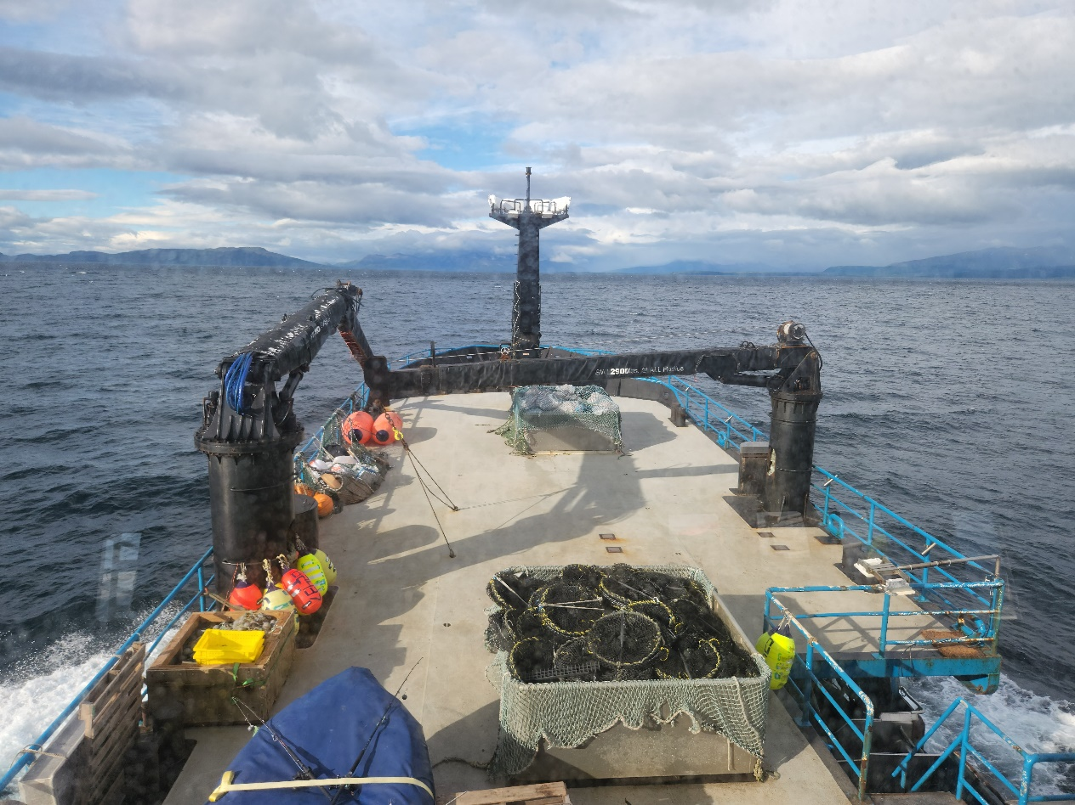
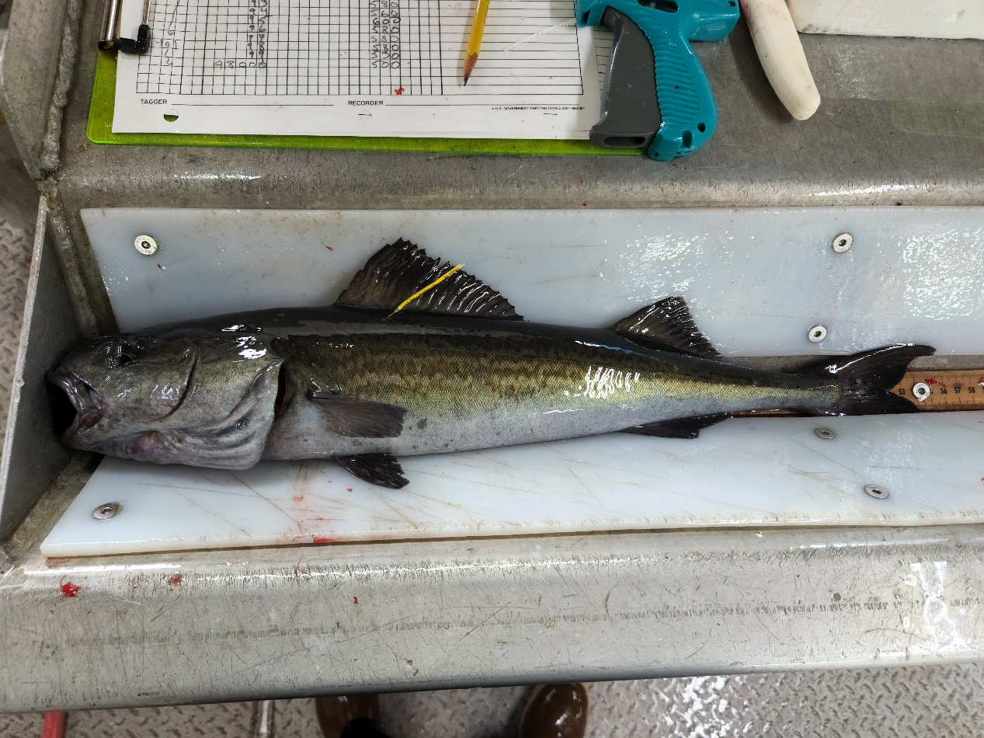

Sablefish Assessment General Methodology
2026 CIE Review
Daniel Goethel and Matt Cheng
June 2026

Slide 2
Agenda

Slide 3
Order of Operations
Now: Background on general assessment framework common to all model types (2026 SAFE, Appendix 3A)
Age structured SCAA
SPoRC assessment platform
Key assumptions/structure
Tomorrow Morning: Summary of closed loop simulations used to identify robust model structures (Appendix 3E)
Tomorrow Afternoon: Model development (Appendices 3B, 3C) and final model results (2026 SAFE, Appendix 3C)
Wednesday: Spatial model development, results, and ongoing work (Appendix 3D)
Documents For Review (available here)
2026 Assessment of the Sablefish Stock in Alaska: 2026 Center for Independent Experts (CIE) Review Document (here)
Appendix 3A. The Spatial Population over Regional Components (SPoRC) Model: Technical Description of the Assessment Model for Sablefish (here)
Appendix 3B. Model Building and Bridging Exercise for the Sablefish Single Region Models (Bridging from Model 25.12 to 26.1_1Reg) (here)
Appendix 3C. Development of a Fleets-as-Areas (FAA) Stock Assessment Model for Alaska Sablefish (Model 26.2_FAA) (here)
Appendix 3D. Results of Spatial Stock Assessment Models for Alaska Sablefish (here)
Appendix 3E. Evaluating Alternative Assessment Structures for Alaska Sablefish Under Survey Design Changes via Closed-Loop Simulation (here)
Days 1-2
Day 2
Day 3
Day 2

Slide 4

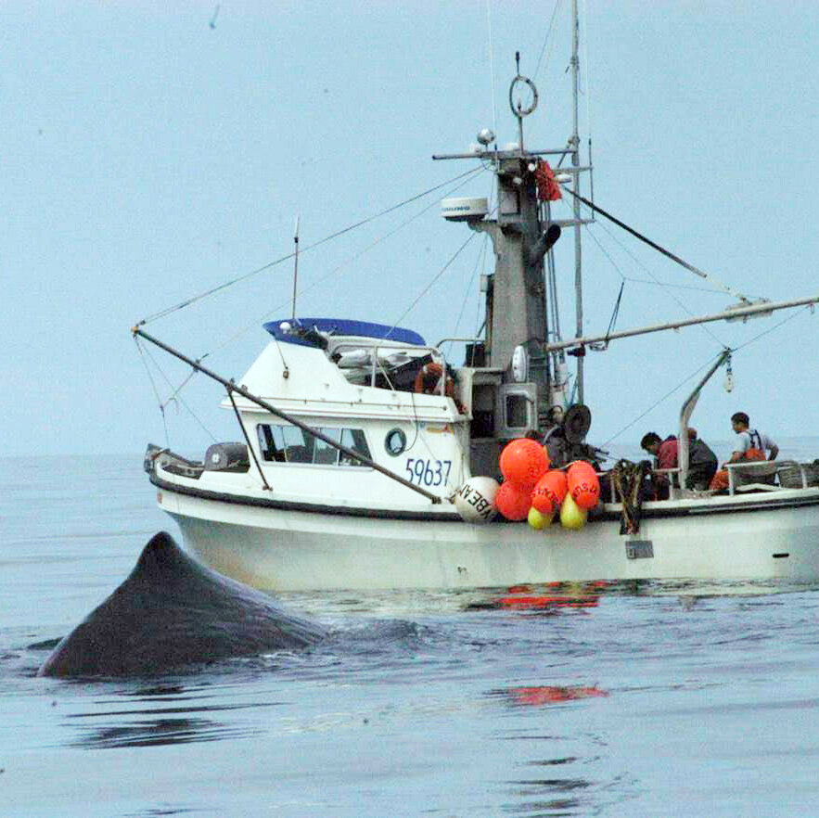
Assessment Biological and Fishery Considerations
Long-lived (low M) and difficult to age (aging error matrix)
Widely distributed (AK-wide assessment) but no population structure (single population)
High mobility with ontogenetic migrations (differential availability to fishery/surveys across regions)
Spasmodic and cyclic recruitment (lack of a well-defined SRR)
Sexually dimorphic (sex-specific growth/selectivity)
Multiple fisheries with different interactions with sablefish (multiple fleets with different selectivity)
ALFA

Slide 5


Assessment Data and Modeling Considerations
How best to handle recent changes in NOAA Longline Survey (LLS) design?
Should a fleets-as-areas (FAA) model be used to avoid extrapolating LLS indices? (ToR 1+2)
Are best practices for modeling sex- and fleet-structure being used in the assessment?
Which data should be included in the assessment (e.g., indices, length compositions)?

Slide 6
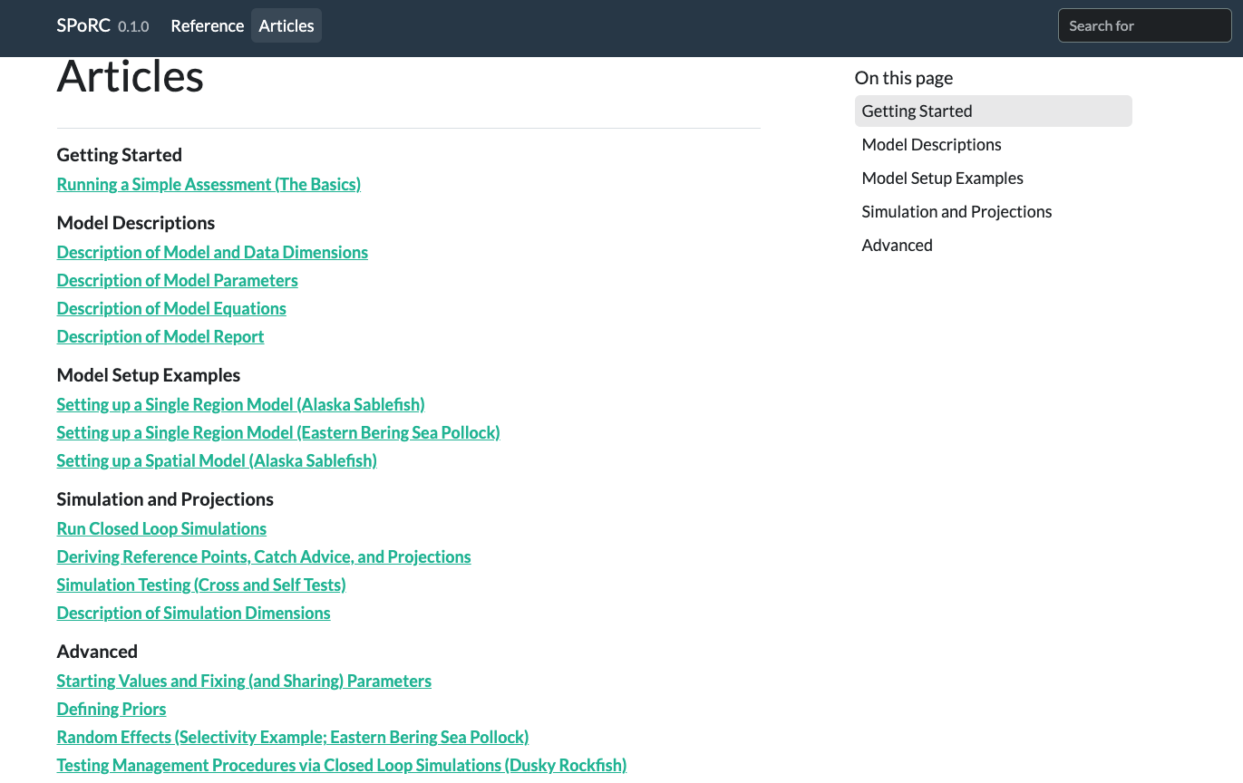

The SPoRC Assessment Package
Stochastic (S) Population (P) over (o) Regional (R) Components (C)
Stock assessment platform written in R and R-TMB
Generalized statistical catch-at-age model with spatial, sex, and fleet-structure
Supports random effects (Laplace Approximation) and Bayesian inference (rstan)
Includes comprehensive stock assessment model diagnostics and simulation tools
Thoroughly documented!
https://chengmatt.github.io/SPoRC/

Slide 7

The SPoRC Assessment Package
Motivated by the needs of Alaska sablefish
Previous models were implemented using custom ADMB code
Difficult to update yearly and keep pace with research and fishery dynamics
Needed a next-generation model that:
Incorporated sex-structure, fleet-structure, and spatial dynamics
Readily transitioned between single-region and multi-region applications
Efficiently estimated random effects
Was modular, flexible, and ‘easy’ to contribute to
Had a fully functional assessment wrapper – catch projections, diagnostics, residual analysis, plotting functions
https://chengmatt.github.io/SPoRC/

Slide 8
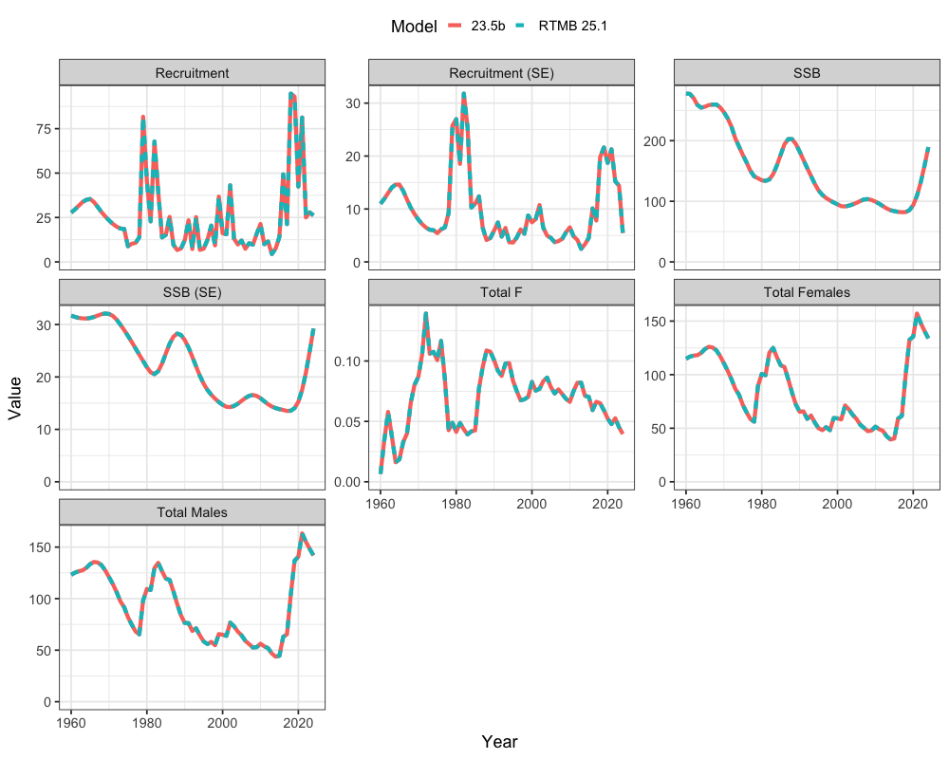
SPoRC Bridging From ADMB
The bespoke ADMB was perfectly emulated in SPoRC (R-TMB)
Relative differences within < 0.001% for likelihood values, time-series estimates, selectivity, and key estimates (including reference points and management advice)
Reviewed and approved by NPFMC Plan Team and Statistical and Scientific Committee
Adopted for the basis of operational assessment in 2025
25.1 Results GitHub Link

Slide 9
Data Integration and Observation Processes

Slide 10
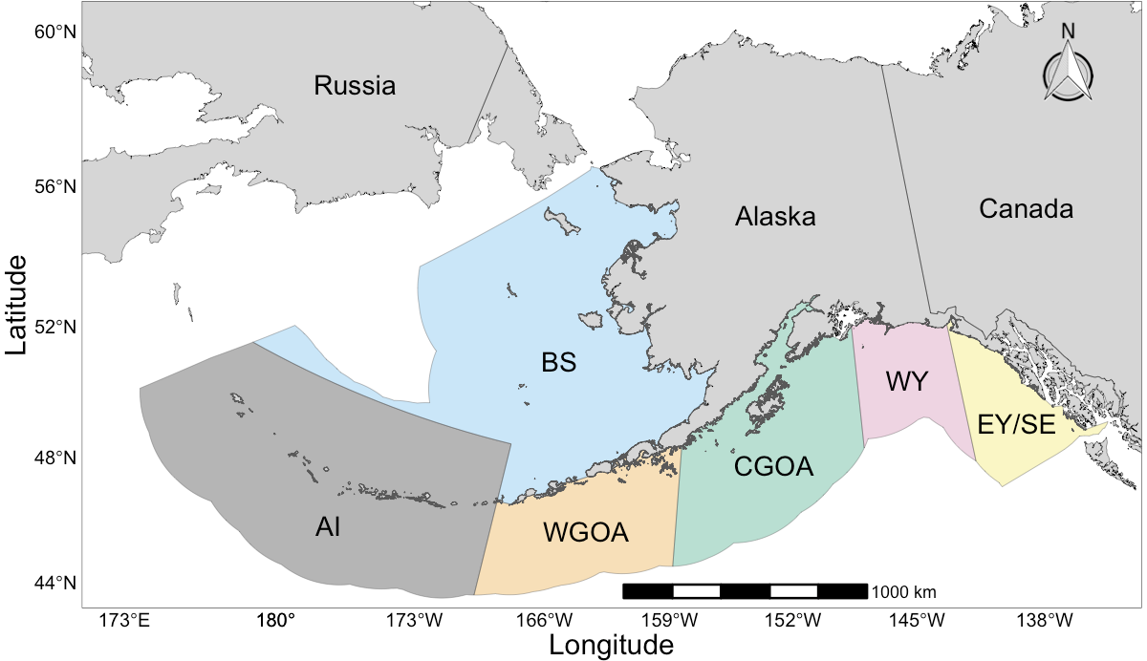
Spatial and Fleet Structure
Two primary models developed that differed only in fleet structure (implicit spatial structure):
26.1_1Reg – Single region panmictic model with no regional fleet structure
All data aggregated to a single region
Matches structure of assessment currently used for management advice (25.12)
26.2_FAA – Single region Fleets-as-Areas (FAA) model that implicitly accounts for regional heterogeneity/ availability/movement implicitly through NOAA Longline Survey fleet structure
All data aggregated to a single region except NOAA Longline Survey indices and age compositions
Disaggregated by region – BS, AI, and GOA
Rest of presentation describes general framework as applies to both models
AK Sablefish Population
Gulf of Alask (GOA)

Slide 11
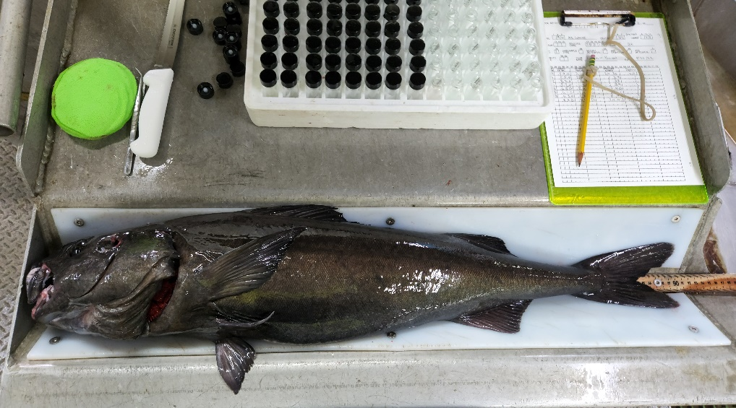
Data Summary
New data for 2026 in bold
Whale depredation by area held constant at 2022 levels
AI and BS Regional NOAA Longline Surveys started in 1996 and 1997, respectively
Francis reweighting applied (Method TA1.8; accounting for correlations among bins)
Source | Data | Years | Probability Distribution
Fixed Gear Fisheries | Catch | 1960 – 2025 | Lognormal
Trawl Fisheries | Catch | 1960 – 2025 | Lognormal
Non-Commercial Catch | Catch | 1977 – 2025 | Lognormal
U.S. Fixed Gear Fishery | Age | 1999 – 2024 | Multinomial (joint by sex)
U.S. Trawl Fisheries | Length | 1990,1991,1999, 2005 – 2024 | Multinomial (joint by sex)
Japanese Longline Survey | RPNs | 1979 - 1994 | Lognormal
 | Length | 1979 - 1994 | Multinomial (joint by sex)
 | Age | 1981, 1985, 1987, 1989, 1991, 1993 | Multinomial (joint by sex)
NOAA Longline Survey | RPNs | 1990 – 2023, 2025 | Lognormal
 | Age | 1996 – 2023 | Multinomial (joint by sex)

Slide 12
Data Summary

Slide 13
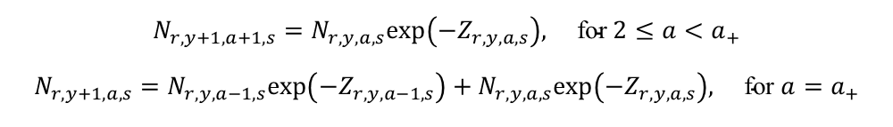
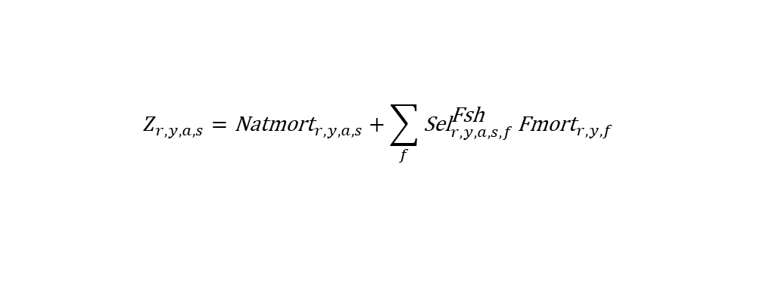
General Model Structure
$$N_{r,y,a=2,s}=μ^{\text{Rec}}exp\left(ε_{r,y}^{\text{Rec}}−\frac{σ_{\text{Rec}}^{2}}{2}b_{y}\right)ψ_{s}ζ_{r}$$
Single region (AK-wide)
Sex-specific (males and females) dynamics:
Growth (size-age transition)
Selectivity
Natural Mortality (M)
50:50 sex ratio
Start year 1960
Age structured (SCAA), projecting forward from initial ages and recruitment at age-2
Assume yearly deviations from average recruitment
Each fleet (fishery and survey) has independent, sex-specific selectivity (and regional LLS selectivity for the FAA model)
Fishing mortality (F) estimated with yearly deviations for each fleet (fixed gear and trawl)
Catchability (q) parameters freely estimated for each index (NOAA and Japanese LLS) and regionally for the FAA model
$$N_{r,y+1,a+1,s}=N_{r,y,a,s}exp\left(−Z_{r,y,a,s}\right), \text{for} 2≤a<a_{+}$$
$$N_{r,y+1,a,s}=N_{r,y,a−1,s}exp\left(−Z_{r,y,a−1,s}\right)+N_{r,y,a,s}exp\left(−Z_{r,y,a,s}\right), \text{for} a=a_{+}$$
$$Z_{r,y,a,s}={\text{Natmort}}_{r,y,a,s}+\sum_{f}{{\text{Sel}}_{r,y,a,s,f}^{\text{Fsh}}}{\text{Fmort}}_{r,y,f}$$
$${\text{Fmort}}_{r,y,f}=μ_{r,f}^{\text{Fsh}}\text{exp}\left(ε_{r,y,f}^{\text{Fsh}}\right)$$

Slide 14
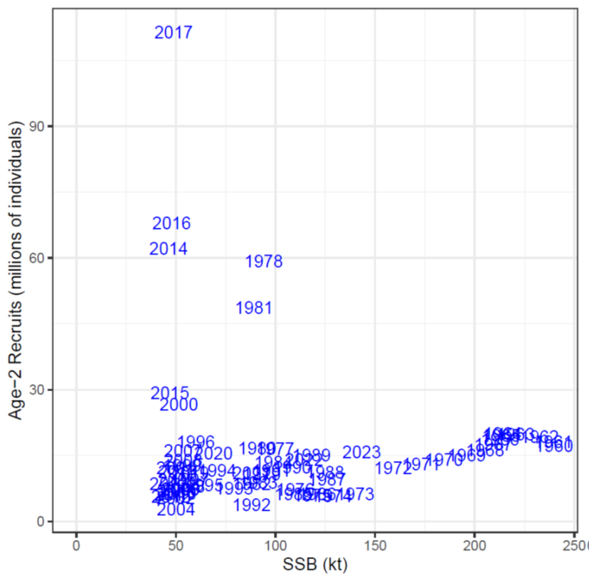
Biology, Recruitment, and Initial Age Structure
Biological parameters input:
Size-age transition matrices (2 blocks pre- and post-1996)
Ageing error matrix
Weight-at-age
Maturity-at-age
Natural mortality ‘estimated’ with a prior ~N(ln(0.085), 0.1²)
Equilibrium age structure with cohort deviations for each initial age
Initial exponential decay assumes 10% of mean fixed gear F
Age-specific deviations applied to equilibrium age structure
Recruitment occurs at age-2 based on average recruitment with deviations
Lognormal bias correction integrated (Methot and Taylor, 2011)
No discernible stock-recruit relationship
High σ_{R} (0.9) to allow adequate estimation of spasmodic recruitment events

Slide 15
Fishing Dynamics
Two fleets: fixed gear and trawl
Fishing mortality estimated with yearly deviations for each fleet
Logistic selectivity assumed for both fleets
Two parameters (i.e., age at 50% selectivity, a_{50%}, and the slope of the curve, k) for each sex/fleet/ time block
Estimated with loose priors ~N(ln(4),1.5²)
Two time blocks assumed for the fixed gear fleet (single time block for trawl)
1960 – 2015, 2016+
Corresponds to transition to pot gear (Cheng et al., 2025)
Age compositions fit for fixed gear fleet and length compositions fit for the trawl fleet

Slide 16
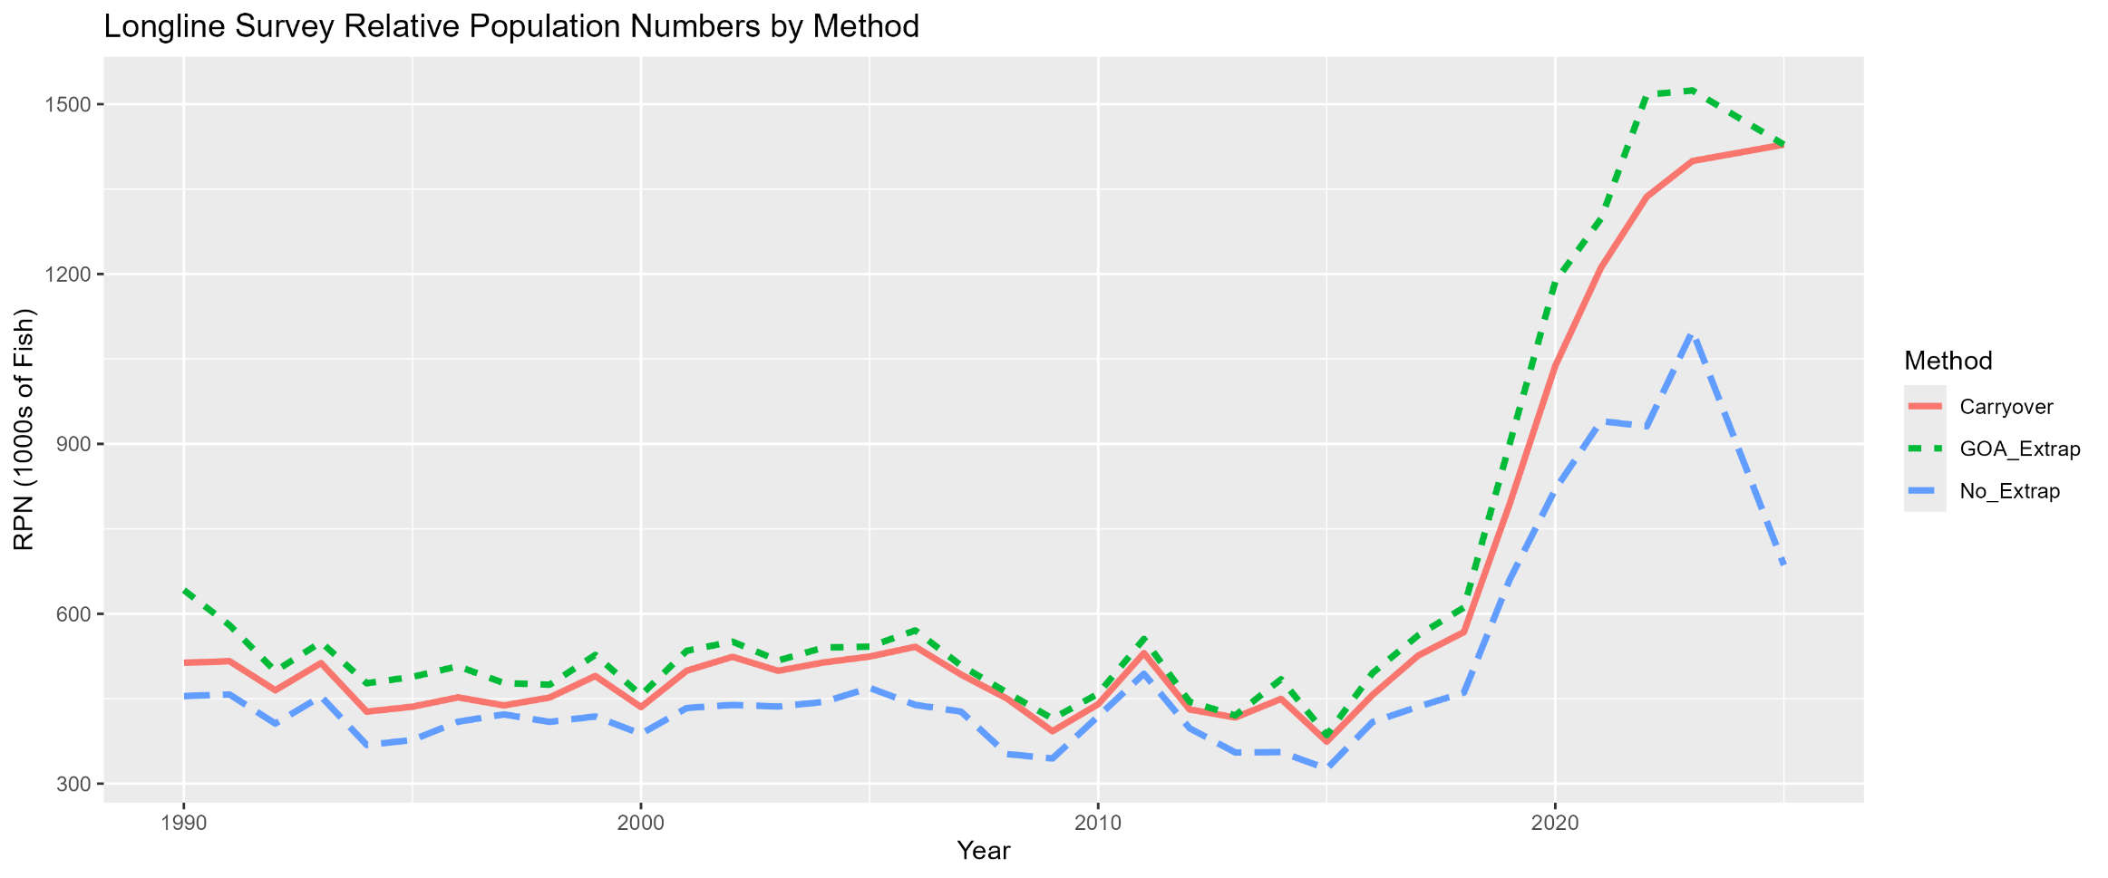
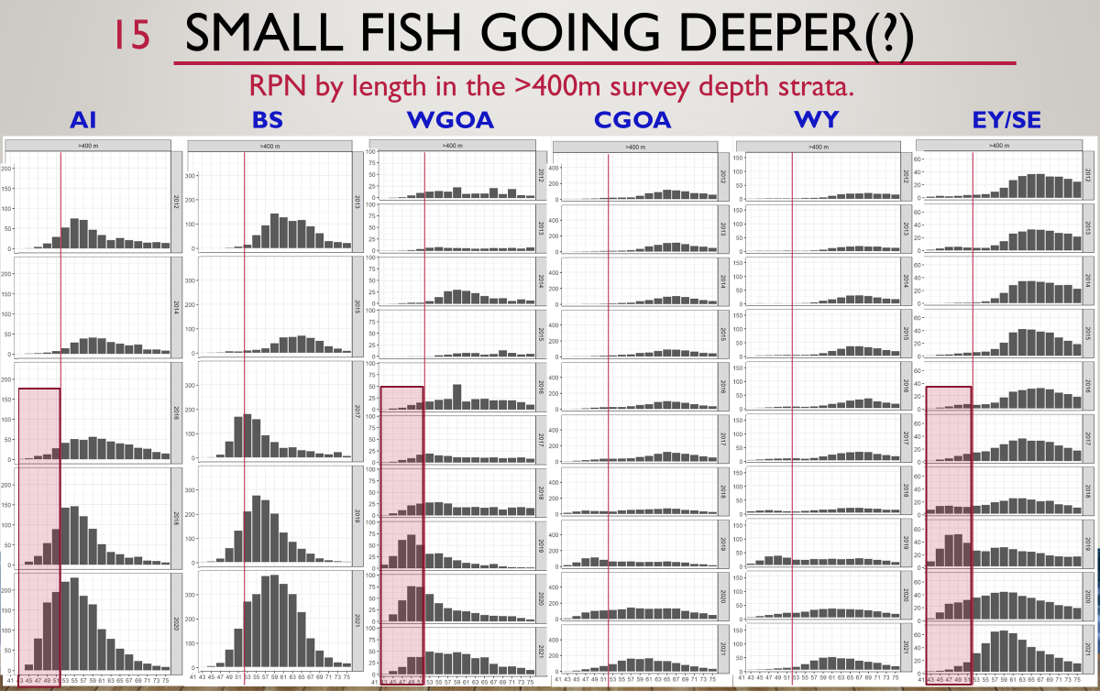
Survey Dynamics – Single Region Model
Two fleets: NOAA LLS and Japanese LLS
Single catchability parameter estimated for each fleet
Logistic selectivity assumed for both fleets
Estimated with loose priors ~N(ln(3),1.5²)
Two time blocks assumed for the NOAA Longline Survey (single time block for Japanese LLS)
1960 – 2015, 2016+
Corresponds to apparent changes in availability to LLS of small fish (small fish in deep strata where not historically observed)
Age compositions fit for the NOAA LLS and both age and length compositions fit for the Japanese LLS
Heatwave Impacts?

Slide 17
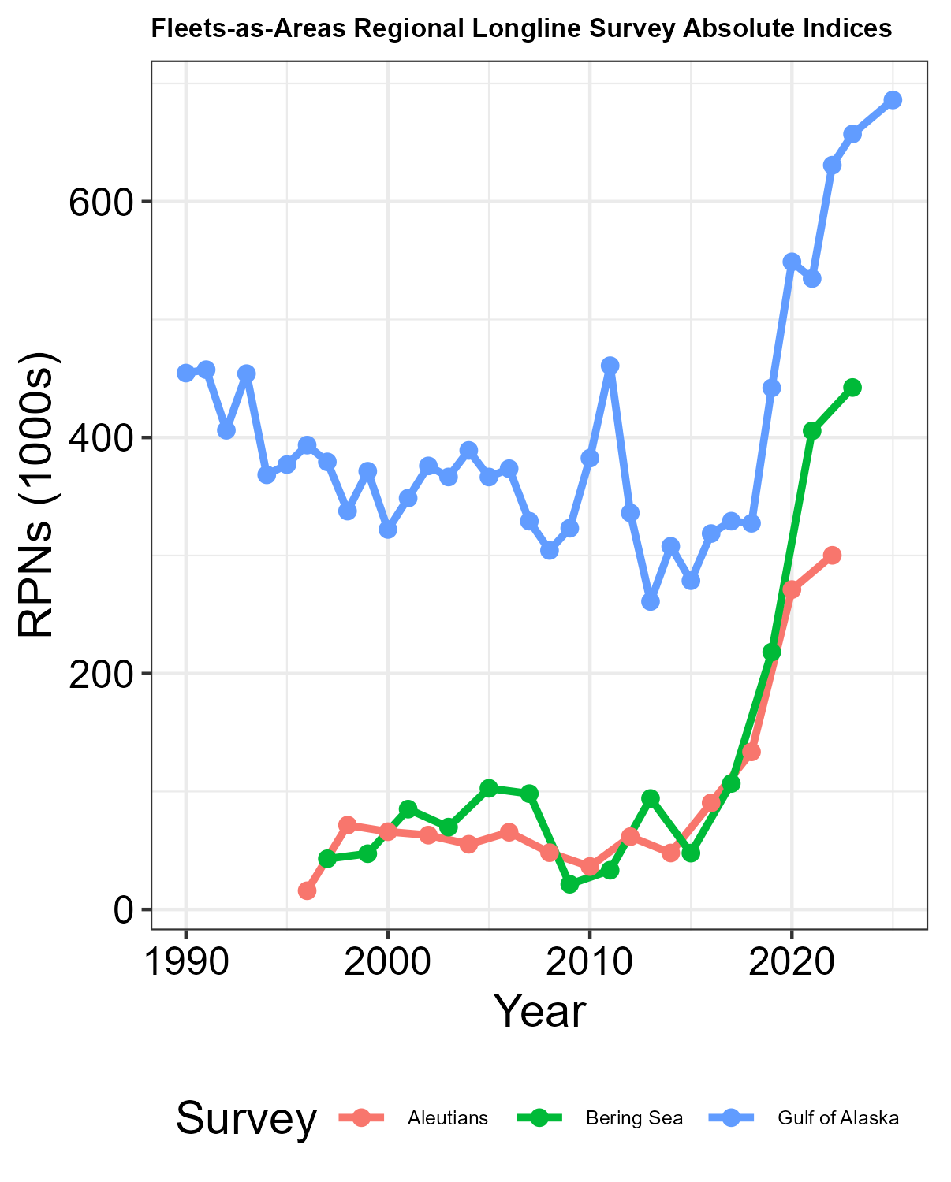
Survey Dynamics – FAA Model
Structured the same as the single region model, but with 3 regional NOAA LLS fleets (BS, AI, GOA)
Single catchability parameter estimated for each regional fleet
Logistic selectivity assumed for all fleets
Estimated with loose priors ~N(ln(3),1.5²)
Two time blocks assumed for each regional LLS fleet
1960 – 2015, 2016+
Age compositions fit disaggregated by region for each regional NOAA LLS fleet
Total of 2 extra q parameters and 16 extra selectivity parameters estimated compared to single region model

Slide 18
Observation Models
Catch assumes a fixed standard error of 0.05 (lognormal)
Survey yearly standard errors calculated from the data (lognormal)
Composition (age/length) Input Sample Sizes (ISS) scaled within fleets relative to observed yearly samples (multinomial)
Fleet-specific maximum values
Minimum ISS of 20
For FAA model, scaling of NOAA LLS ISS was across regions to maintain information on relative sample sizes across regions
ESS determine from Francis reweighting

Slide 19
Priors and Estimated Parameters
MLE with penalized likelihood used to estimate parameters
Priors:
Recruitment deviations ~N(0, σ_{R}²)
Fishing mortality deviations ~N(0, 0.75²)
Natural morality ~N(ln(0.085), 0.1²)
Fishery selectivity parameters ~N(ln(4),1.5²)
Survey selectivity parameters ~N(ln(3),1.5²)
Total estimated parameters
Single region: 253
FAA: 271

Slide 20
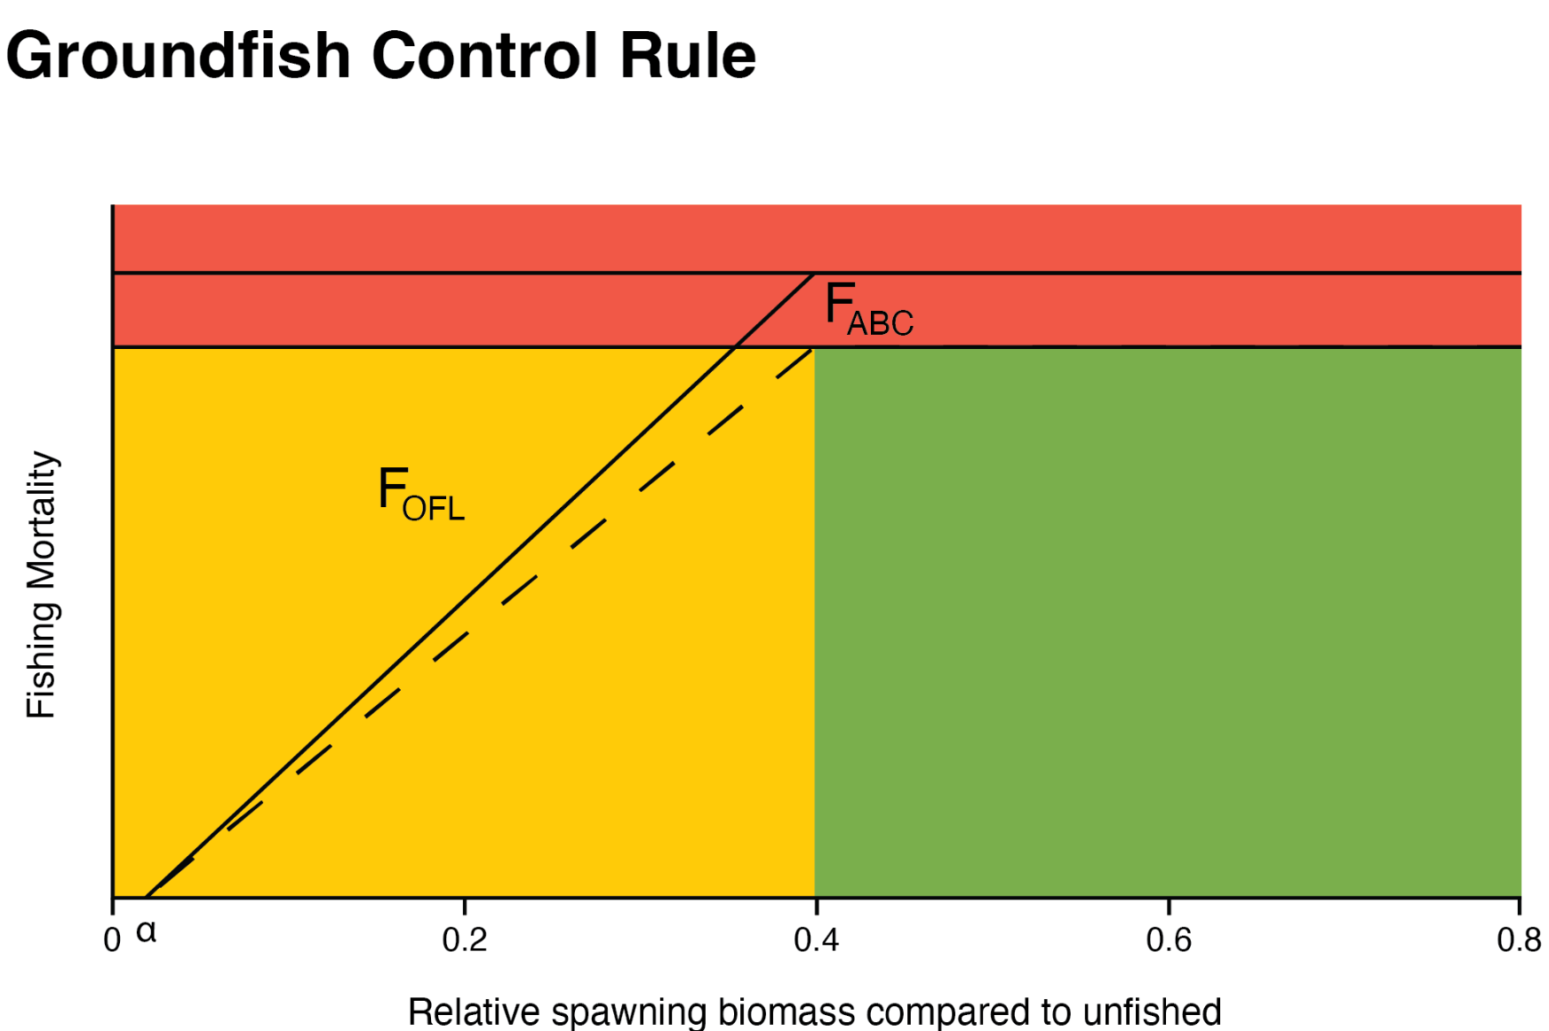
Catch Projections and Reference Points
Standard methods for reference points (per-recruit) and associated catch projections used by all AFSC assessments
Parameters (e.g., relative fishing mortality among fishing fleets, selectivity, natural mortality, and biological inputs) are taken from the terminal year of the assessment
Biomass reference points (B40%) are calculated from per-recruit reference points based on average recruitment (1979 – terminal assessment year - 2)
F_{ABC} is defined as F40% and F_{OFL} is defined as F35%, except when reduced by the NPFMC threshold/sloped HCR due to SSB falling below SSB_{OFL} (B35%)
For projections:
Start from the terminal year numbers-at-age
Recruitment is simulated as an inverse Gaussian distribution parameterized using based on average recruitment and variance (1,000 simulations)
A standard set of seven projections is required for each stock

Slide 21


Summary
All models developed in the SPoRC generalized assessment package
Two primary models to be compared:
26.1_1Reg: Single region panmictic model
26.2_FAA: FAA model with regional NOAA LLS fleets
Structure between the two models are essentially identical except for LLS fleet parametrization (and associated data fitting)
Rationale for the two models and associated model building steps (including simulation analyses) to be presented tomorrow

Slide 22





QUESTIONS?

